Slide 1
Summary of Infection Prevention Practices in Dental Settings:
Basic Expectations for Safe Care
PRESENTER:
ABBY TEH RDA.OA.CDA

Slide 2
PROGRAM OBJECTIVES
1. Introduction
2. Hand Hygiene
3. Personal Protective Equipment
4. Respiratory Hygiene/Cough Etiquette
5. Sharps Safety
6. Safe Injection Practices
7. Sterilization and Disinfection of Patient-Care Items and Devices
8. Environmental Infection Prevention and Control
9. Dental Unit Water Quality
10. Program Evaluation

Slide 3
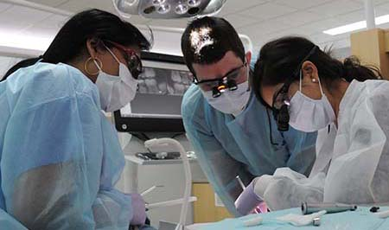
Importance of Infection Prevention in Dentistry
Both patients and dental health care personnel (DHCP) can be exposed to disease-causing organisms.
1
Contact with blood, oral and respiratory secretions, and contaminated equipment occurs.
2
Proper procedures can prevent transmission of infections among patients and DHCP.
3

Slide 4

Bloodborne Pathogens
Bloodborne viruses such as hepatitis B virus (HBV), hepatitis C virus (HCV), and human immunodeficiency virus (HIV):
Are transmissible in health care settings.
Can produce chronic infection.
Are often carried by persons unaware of their infection.

Slide 5
Potential Routes of Bloodborne Pathogens
Patient to DHCP - Highest Risk
DHCP to Patient
Patient to Patient
Dental Office to Community (including dental team’s family)
Community to dental office to patient

Slide 6
Standard Precautions
Primary way to prevent transmission of infectious agents.
• MUST be used in the care of all patients, regardless of their infection status.
• Elements include:
– Hand hygiene.
– Using personal protective equipment.
– Respiratory hygiene/cough etiquette.
– Sharps safety, including engineering and work practice controls.
– Safe injection practices.
– Sterilization and disinfection of instruments and devices.
– Cleaning and disinfecting environmental surfaces.

Slide 7
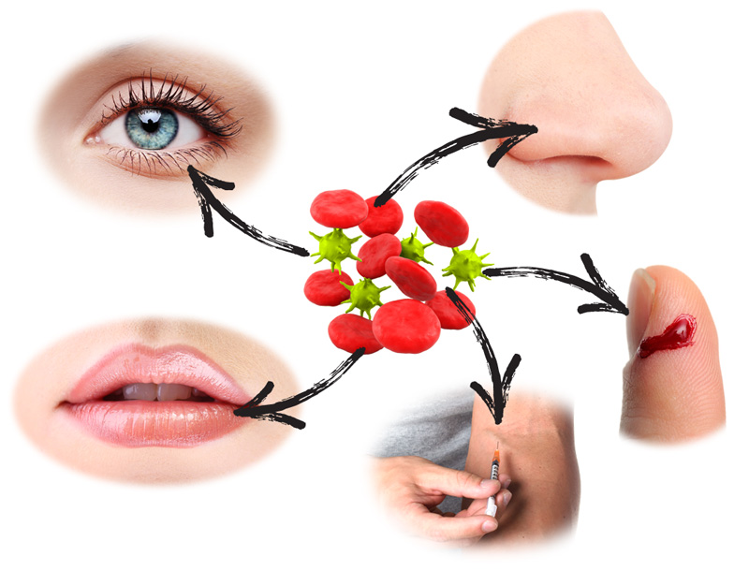
Transmission-Based Precautions
• Some patients require additional measures: transmission-based precautions.
• Always used in addition to standard precautions to interrupt the spread of certain pathogens.
• Three categories:
– Airborne.
– Droplet (larger than 5 microns).
– Contact.
• More than one transmission category may apply

Slide 8
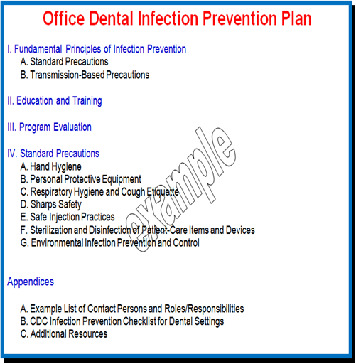
Administrative Measures
Make infection prevention a priority in all dental settings.
Assign at least one person as the infection control coordinator.
Tailor policies to each dental setting.
Reassess on a regular basis (e.g., annually).

Slide 9
Infection Prevention Education and Training
Critical to ensure that infection prevention practices are understood and consistently followed.
Provide job or task-specific education and training
- Upon hire for all new staff.
- When new tasks or procedures are introduced.
- At least annually.
Include both DHCP and patient safety.

Slide 10
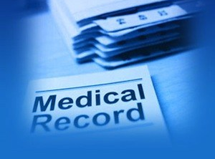
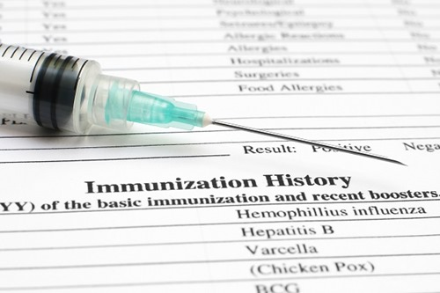
Dental Health Care Personnel Safety
Immunizations.
Exposure prevention and postexposure management.
Medical condition management and work-related illnesses and restrictions.
Health record maintenance

Slide 11
Hepatitis B Immunization
OSHA requires the dentist to offer the hepatitis B virus (HBV) vaccination series to all employees whose jobs include category I and II tasks.
Vaccine must be offered within 10 days of employment.
The dentist/employer must obtain proof from the physician who administered the vaccination.
The employee has the right to refuse the HBV vaccine; however, the employee must sign an informed refusal form that is kept on file in the dental office.
The employee always has the right to change his or her mind and receive the vaccine at a later date at no charge.

Slide 12

Employee Medical Records
The dentist/employer must keep a confidential medical record for each employee.
These records are confidential and must be stored in a locked file.
The employer must keep these records for 30 years.

Slide 13
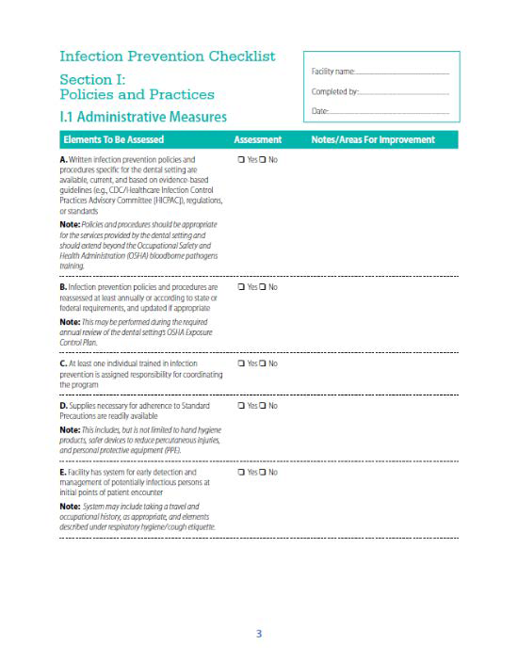
Infection Prevention Checklist for Dental Settings
Checklist to evaluate compliance with infection prevention practices.
Section 1: Policies and Practices
Section 2: Direct Observation of Personnel and Patient-Care Practices.

Slide 14
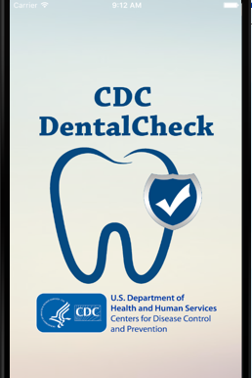
CDC Dental Check—Mobile App
Interactive version of the Infection Prevention Checklist for Dental Settings.
Available for all mobile iOS and
Android compatible devices.
Free download at the iTunes App and Google Play Stores.

Slide 15
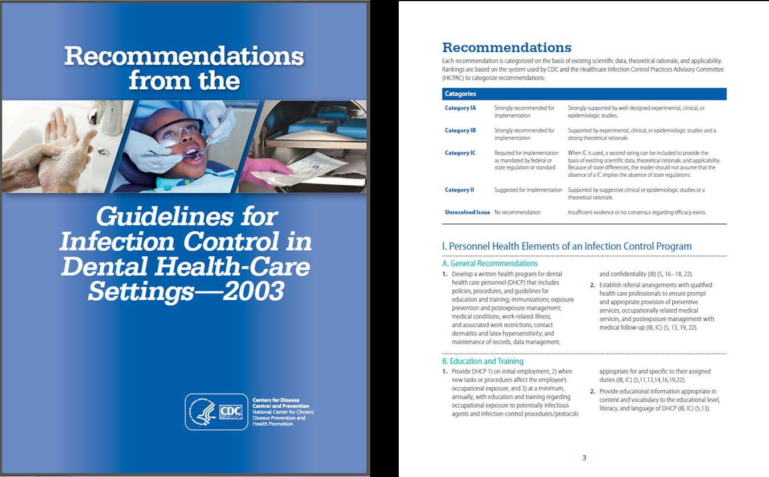
Compendium Document
RR5217 Dental Front.pmd (cdc.gov)

Slide 16
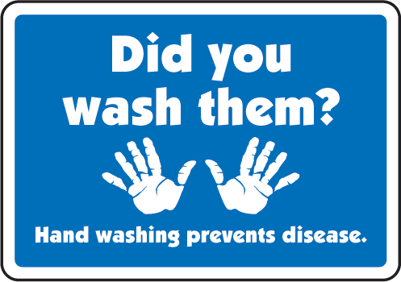
Hand Hygiene is Key for Prevention
Is a critical practice for preventing the transmission of pathogens in health care settings.
•Reduces harmful microorganisms on the hands.
•Compliance with hand hygiene practices is routinely used as a clinical performance indicator in hospital settings.
•Is expected by patients to be performed by all dental health care personnel (DHCP).

Slide 17
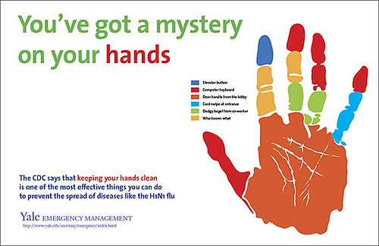
Why Is Hand Hygiene Important?
Hand Hygiene
  Hands are the most common mode of pathogen transmission.
  Reduce spread of antimicrobial resistance.
  Prevent health care-associated infections

Slide 18
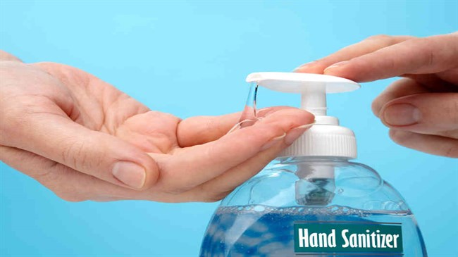
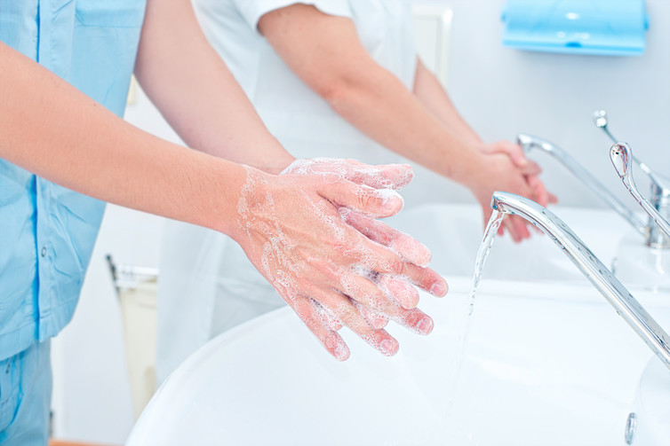
Hand Hygiene
The term “hand hygiene” includes both handwashing with either plain soap or antimicrobial soap and use of alcohol-based hand rubs that do not require the use of water.

Slide 19
Key Recommendations for Hand Hygiene
Perform hand hygiene:
- When hands are visibly soiled.
- After barehanded touching of instruments, equipment, materials, and other objects likely to be contaminated by blood, saliva, or respiratory secretions.
- Before and after treating each patient, even if gloves are worn.
- Immediately after removing gloves.
Use soap and water when hands are visibly soiled (e.g., blood, body fluids). Otherwise, an alcohol-based hand rub may be used.

Slide 20
Hand Hygiene for Routine Dental Procedures
Scenario | Soap and Water | Antimicrobial Soap and Water | Alcohol-Based Hand Rub
If hands are visibly soiled (e.g., dirt, blood, body fluids). | YES | YES | NO
If hands are not visibly soiled. | YES | YES | YES

Slide 21
Hand Hygiene for Surgical Procedures
Scenario | Soap and Water Alone | Antimicrobial Soap and Water | Soap and Water Followed by Alcohol-Based Hand Rub
Surgical hand antisepsis before gloving | NO | YES | YES

Slide 22
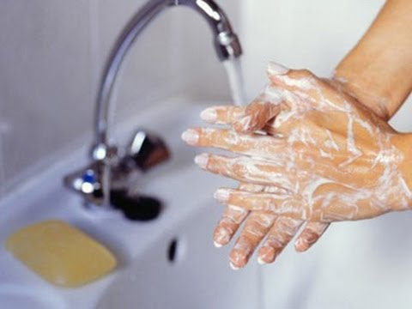
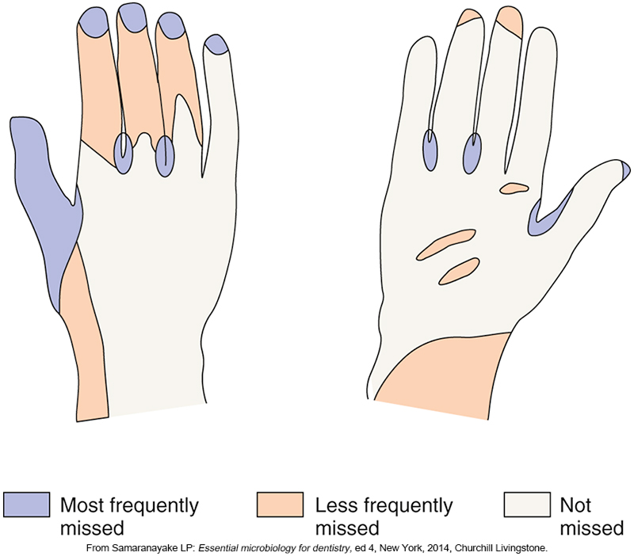
Hand Washing Technique
Wet hands with water, apply soap, and rub hands together for at least 15 seconds.
Rinse hands and dry with a disposable towel.
Use towel to turn off faucet.

Slide 23
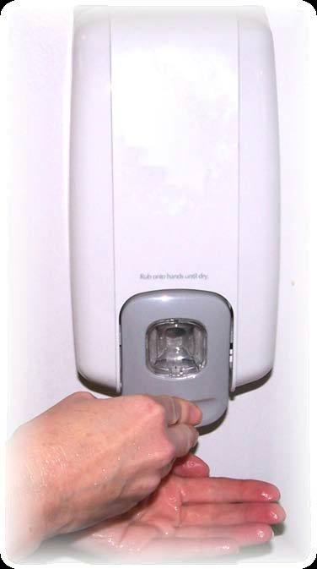
Using an Alcohol-Based Hand Rub
Apply to palm of one hand and rub hands together covering all surfaces until dry.
Use amount recommended by manufacturer’s instructions.
Do not use if hands are visibly soiled.

Slide 24
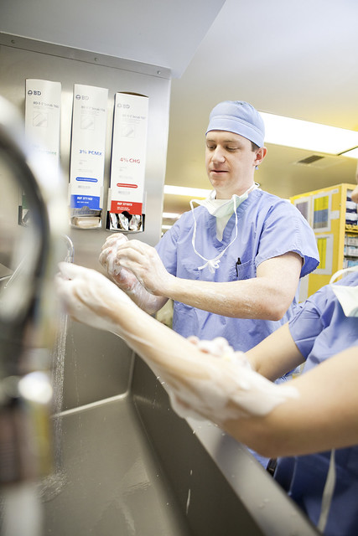
Surgical Hand Hygiene
Antimicrobial soap—scrub hands and forearms for length of time recommended by manufacturer.
OR
Alcohol-based hand rub—follow manufacturer’s recommendations.
- Before applying, prewash hands and forearms with non antimicrobial soap.

Slide 25
Efficacy of Hand Hygiene Preparations in Reducing Bacteria
Alcohol-Based Hand Rubs Are More Effective in Killing Bacteria Than Soap and Water
GOOD | BETTER | BEST
REGULAR SOAP | ANTIMICROBIAL SOAP | ALCOHOL-BASED HAND RUB (FOAM OR GEL)

Slide 26
Alcohol-Based Preparations
Benefits | Limitations
Rapid and effective antimicrobial action. Improved skin condition. More accessible than sinks. | Cannot be used if hands are visibly soiled. Must be stored away from high temperatures or flames. Hand softeners and glove powders may build up on hands.

Slide 27
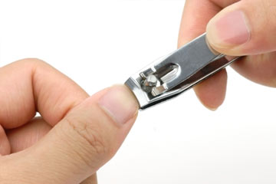

Special Hand Hygiene Considerations
Use hand lotions to prevent skin dryness.
Consider compatibility of hand care products with gloves (e.g., mineral oils and petroleum bases may cause early glove failure).
Keep fingernails short.
Avoid artificial nails.
Avoid hand jewelry that may tear gloves.

Slide 28
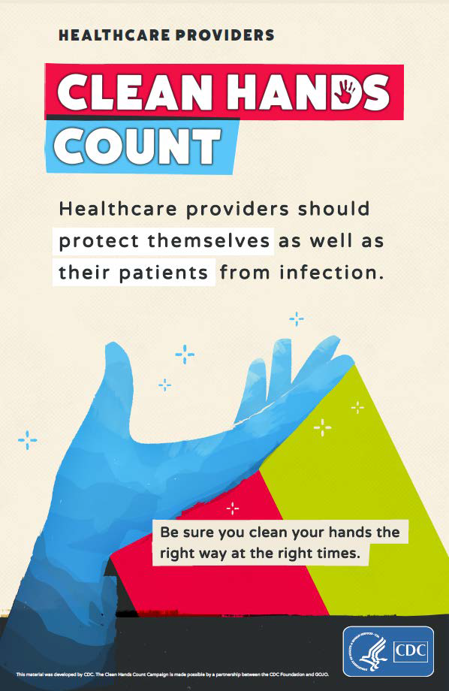
Reminders in the Workplace
Reminders can be used to prompt DHCP about the importance of hand hygiene.
Reminders also inform patients about the standard of care they should expect.

Slide 29
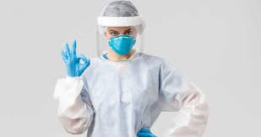
Personal Protective Equipment
Protects the skin and mucous membranes from exposure to infectious materials in spray or spatter.
Should be worn whenever there is potential for contact with spray or spatter.
Should be removed when leaving work areas.

Slide 30
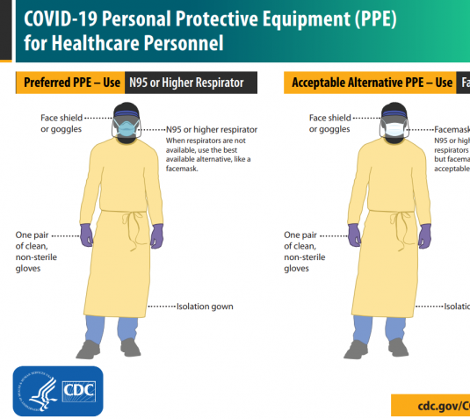
CDC’s PPE Recommendations for Dental Settings
For procedures likely to generate splashes: gloves + eye protection + gown (or protective clothing) + surgical mask
For aerosol generating procedures: gloves + eye protection + gown + N95 or higher-level respirator (instead of surgical mask)

Slide 31
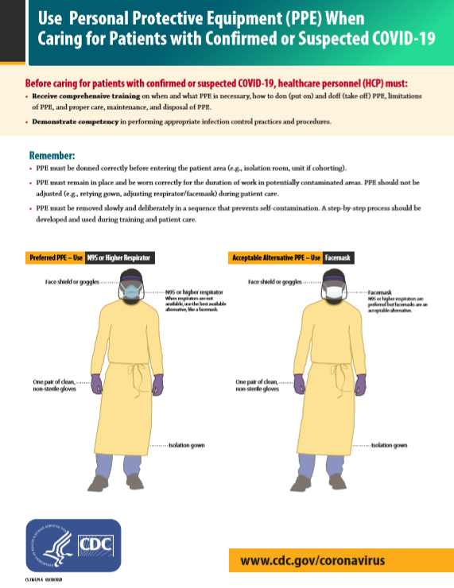
CDC’s PPE Recommendations for Dental Settings
For patients with suspected or confirmed COVID-19: gloves + eye protection + gown + N95 or higher-level respirator
Respirator should be used in the context of a respiratory protection program, which include medical evaluations, training, and fit testing.
Dental Care Health Personnel (HCP) should receive training on how to put on, use and take off PPE

Slide 32
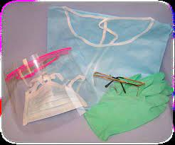
Masks, Protective Eyewear, Face Shields
Wear a surgical mask and either eye protection with solid side shields or a face shield to protect mucous membranes of the eyes, nose, and mouth.
Change masks:
- Between patients.
- If mask becomes wet during patient treatment.
Clean reusable face protection:
- Between patients (with soap and water).
- If visibly soiled (by cleaning and disinfecting).

Slide 33
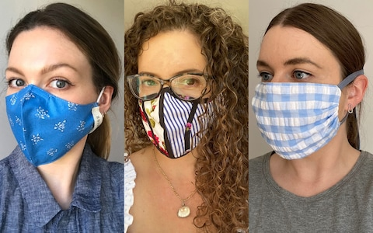
Mask and Face Cloth Covering
A Facemask or cloth face covering must be worn at all times by dental workers when in the office
Business staff must also wear a cloth face covering or face mask while performing their duties
Dentist, dental assistant, and hygienist may wear cloth face covering when not involved in direct patient care, but mush switch to a surgical face mask respirator when providing patient care
Surgical mask are regulated by the FDA and must meet certain testing guidelines

Slide 34
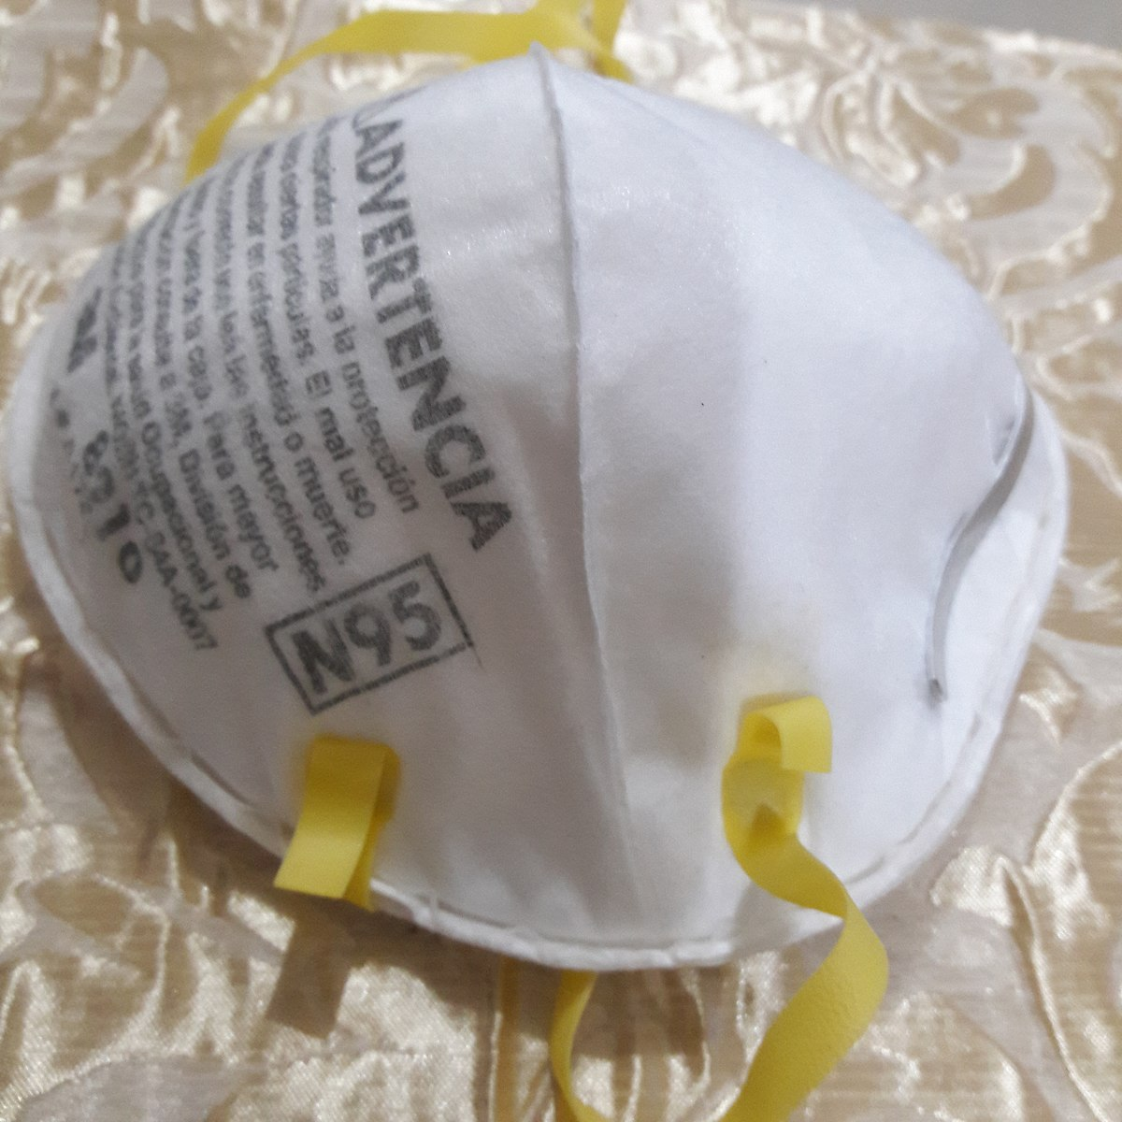
Do Dental Offices Need N95 Mask?
N95 mask are considered “respirators by OSHA and have strict requirement which include having a written respiratory protection plan, fit testing, and a medical evaluation of those individuals who will wear them
Should be used during the COVID_19 pandemic if doing an aerosol procedure on a patient NOT suspected of having a COVID-19 infection.
This means if you operate a high- or low-speed handpieces , an ultrasonic scaler, or use an air/water syringes, you should be using an N95 mask, as these procedures have potential to generate aerosol.
Remember, we should NOT be treating “known or suspected COVID-19 patient in your office, as they should be treated in a special facility with negative air pressure isolation.

Slide 35
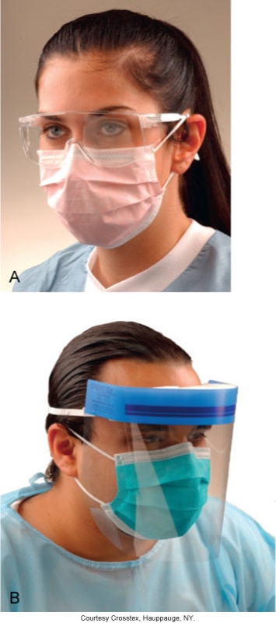
Protective Eyewear
When entering an operatory containing a patient who has been screened and does not appear to have COVID-19 , a surgical mask with eye protection (Goggle, safety glasses with side shield or a full-face shield) may be worn if not performing aerosol –generating procedures.
If you be performing an aerosol-generating procedures on a screened patient, an N95 or equivalent must replace the surgical face mask and face shield must be used for eye protection
Face shield provide not only excellent eye and face protection, but protect the N95 from moisture contamination
Clean and disinfect reusable eye protection according to manufacturer’s reprocessing instructions.

Slide 36
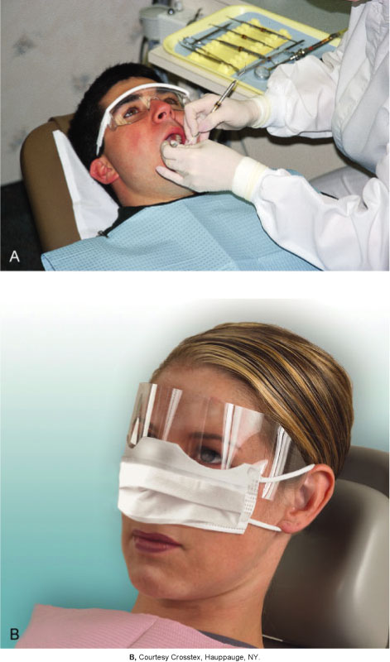
Patient Safety Eyewear
Patient eye protection is the standard care! Make sure all patients wear protective eyewear when they having dental treatment.

Slide 37
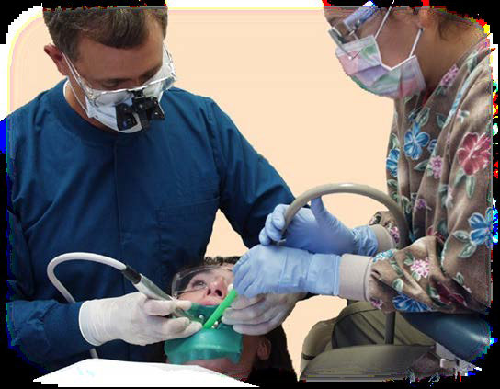
Protective Clothing
Wear gowns or lab coats that cover skin and personal clothing likely to become soiled with blood, saliva, or infectious material.
Change if visibly soiled.
Remove all barriers before leaving the work area.

Slide 38
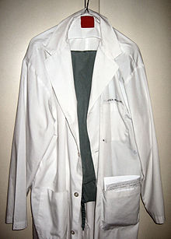
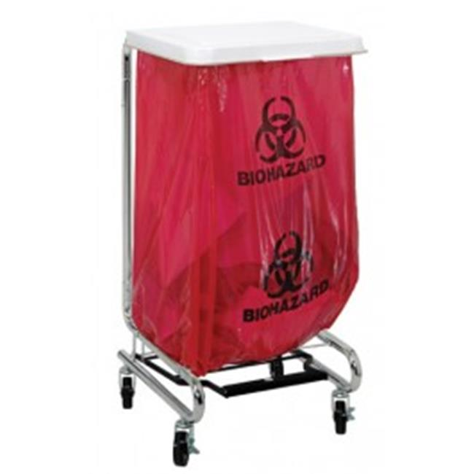
Handling Contaminated Laundry
The BBP Standard states the protective clothing may not be taken home and washed by employees.
It may be laundered in the office if the equipment is available and if Standard Precautions are followed for handling and laundering the contaminated clothing.
Contaminated linens that are removed from the office for laundering should be placed in a leakproof bag with a biohazard label or an appropriately color-coded label.
Disposable gowns must be discarded daily and more often if visibly soiled.

Slide 39
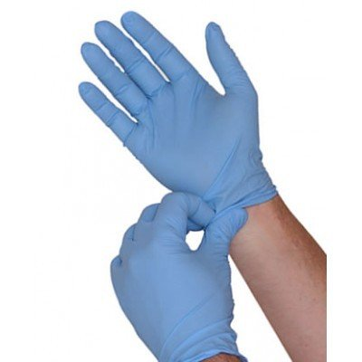
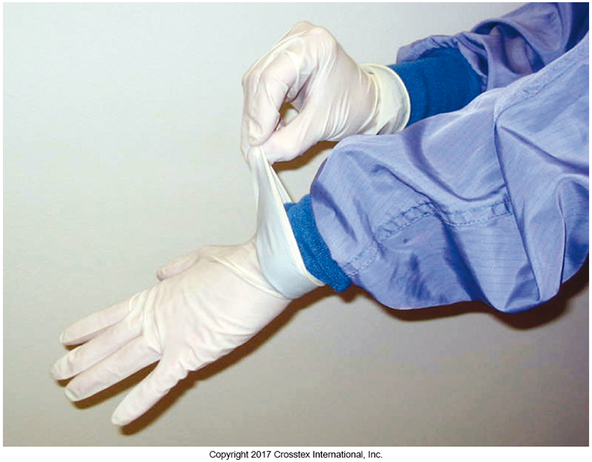
Gloves
Prevent contamination of DHCP’s hands when touching mucous membranes, blood, saliva, or other potentially infectious materials.
Reduce the likelihood that microorganisms present on the hands of DHCP will be transmitted to patients during surgical or other patient-care procedures.
Do not eliminate or replace the need for hand washing.

Slide 40
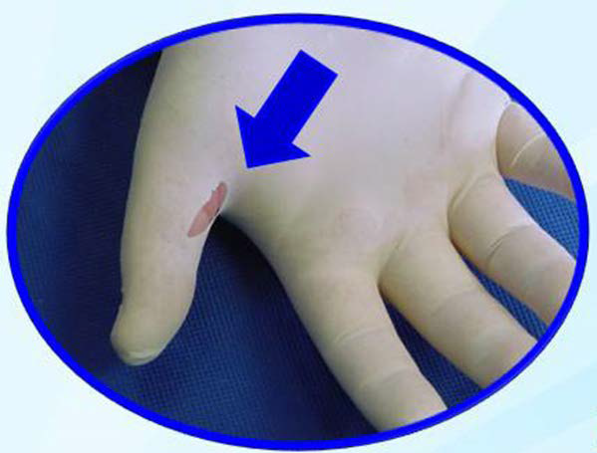
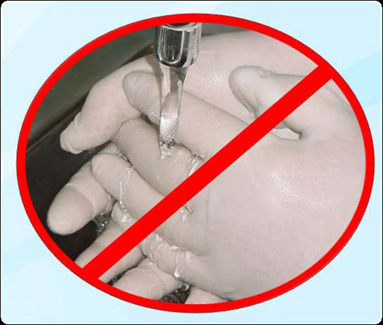
Glove Recommendations
Remove gloves that are torn, cut, or punctured Do not wash, disinfected or sterilize
medical gloves for reuse

Slide 41
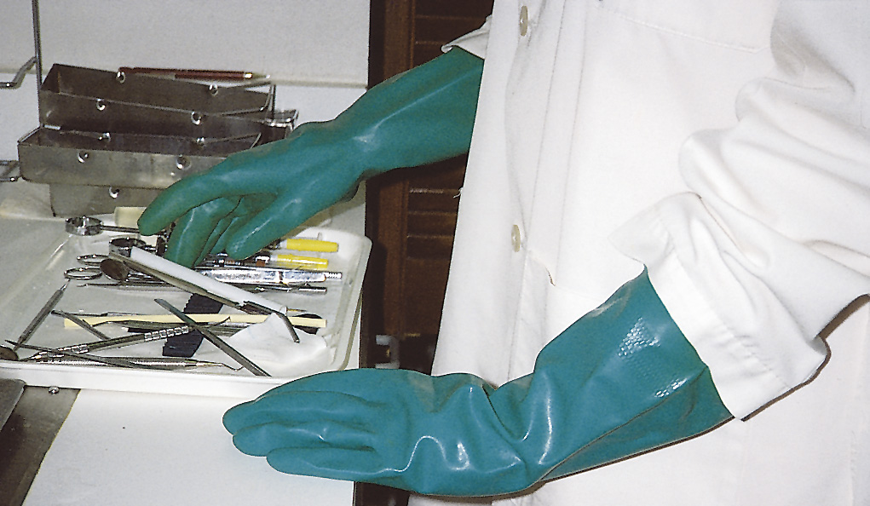
Utility Gloves
Utility gloves are not used for direct patient care.
Utility gloves must be worn:
  When the treatment room is being cleaned and disinfected between patients.
  While contaminated instruments are being cleaned or handled.
  For surface cleaning and disinfection.
Utility gloves may be washed, disinfected, or sterilized and reused.
Used utility gloves must be considered contaminated and handled appropriately until they have been properly disinfected or sterilized.

Slide 42
Putting On and Removing PPE
Follow recommended sequences for PPE donning and removal.
Recommended sequences and related material available at Protecting Healthcare Personnel

Slide 43
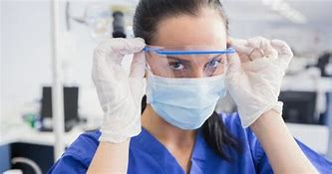

Safe Work Practices
Keep gloved hands away from face.
Limit surfaces and items touched.
Change gloves when torn.
Remove PPE when leaving work areas.
Perform hand hygiene immediately after removing PPE.

Slide 44
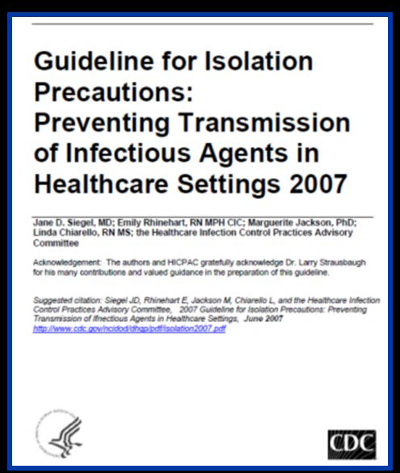
Respiratory Hygiene/Cough Etiquette
New Elements Added to Standard Precautions in 2007
Infection control problems that are identified in the course of outbreak investigations often indicate the need for new recommendations or reinforcement of existing infection control recommendations to protect patients.
  Two areas of practice relevant to dentistry were added:
  Respiratory hygiene/cough etiquette.
  Safe injection practices.

Slide 45
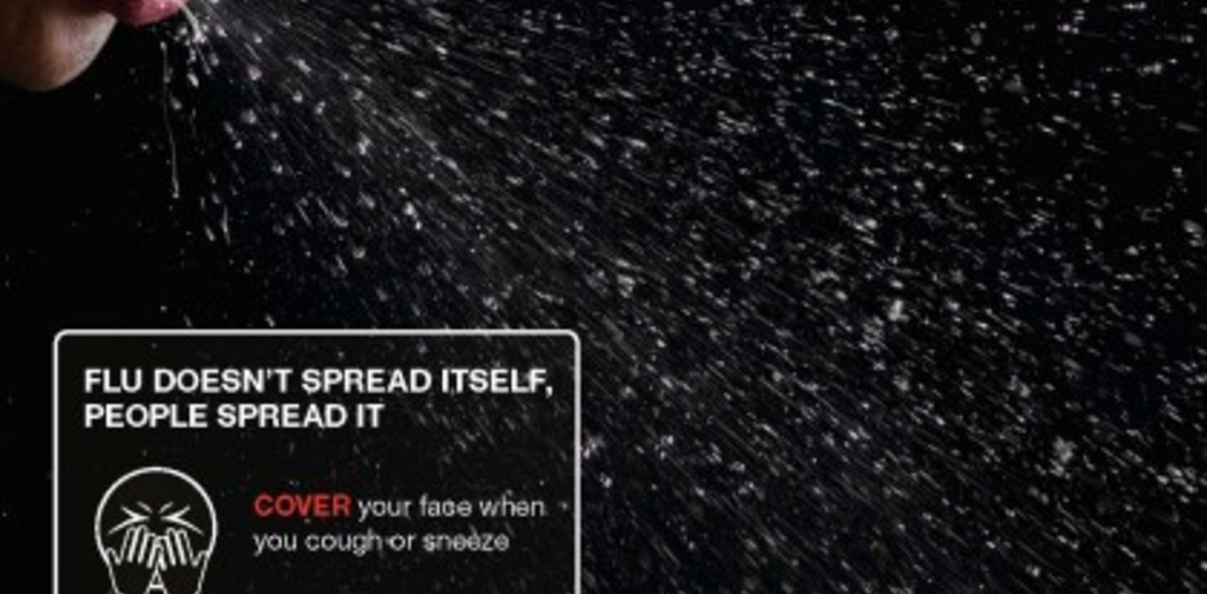
Respiratory Hygiene/Cough Etiquette
Based on observations made during severe acute respiratory syndrome (SARS) outbreaks, where failures to implement simple source control measures with patients, visitors, and health care personnel with respiratory symptoms may have contributed to SARS transmission.

Slide 46
Respiratory Hygiene/Cough Etiquette
Combination of infection prevention measures designed to limit the transmission of respiratory pathogens spread by droplet or airborne routes.
First point of encounter.
Strategies target:
– Patients and visitors who might have undiagnosed transmissible respiratory infections.
– Anyone with signs of illness, including cough, congestion, runny nose, or increased production of respiratory secretions.

Slide 47
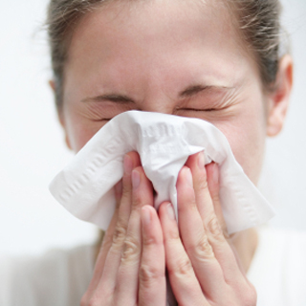
Measures to Contain Respiratory Secretions
Cover mouth and nose with a tissue when coughing or sneezing.
Use the nearest waste receptacle to dispose of tissues after use.
Perform hand hygiene after having contact with respiratory secretions and contaminated objects or materials.
Offer masks to coughing patients and other symptomatic people when they enter the dental setting.
Encourage people with symptoms to sit as far away from others as possible.

Slide 48
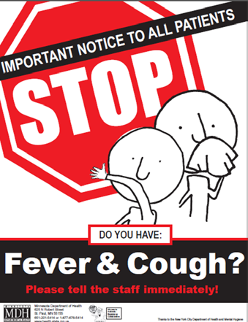
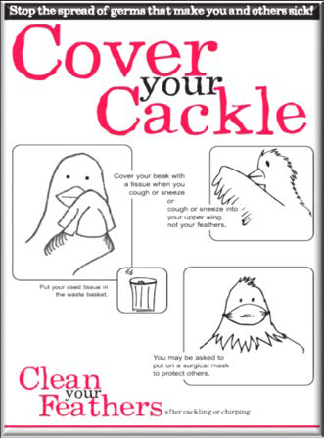
Visual Alerts
Display visual cues to remind staff and patients of proper ways to prevent spread of respiratory pathogens.
Related materials are available at Cover Your Cough and Important Notice to All Patients

Slide 49
Supplies
Dental health care facilities should ensure the availability of:
Tissues and no-touch waste receptacles for disposing of used tissues.
Dispensers of alcohol-based hand rub and handwashing materials (when a sink is available).
Masks (for coughing patients and other people with symptoms).

Slide 50
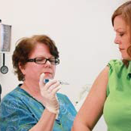
Additional Considerations
DHCP should be educated on how to prevent the spread of respiratory pathogens when in contact with people with symptoms.
CDC recommends that health care workers get one dose of influenza vaccine annually.

Slide 51
Percutaneous Injuries Among Dental Health Care Personnel
Defined as needlestick or cut with sharp object.
Most involve burs, needles, and other sharp objects.
The Occupational Safety and Health Administration (OSHA’s) Bloodborne Pathogens Standard helps to protect dental health care personnel (DHCP) from blood exposure and sharps injuries.
These injuries pose the risk of bloodborne pathogen transmission to DHCP and patients.

Slide 52
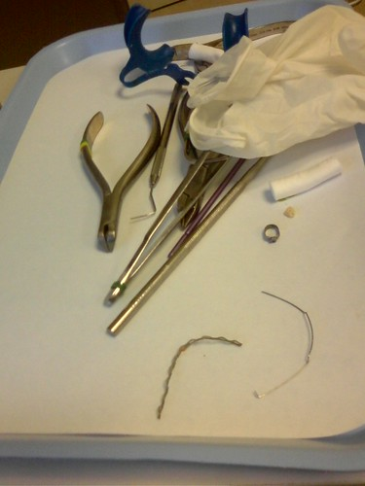
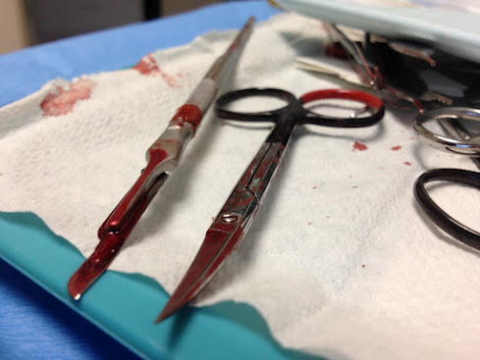
Sharps Safety
Most exposures in dentistry are preventable.
Each dental practice should have policies and procedures in place that address sharps safety:
– Take precautions while using sharps.
– Take precautions during cleanup.
– Take precautions during disposal.
• Prevention is primary.

Slide 53
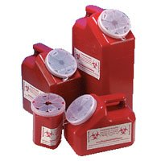
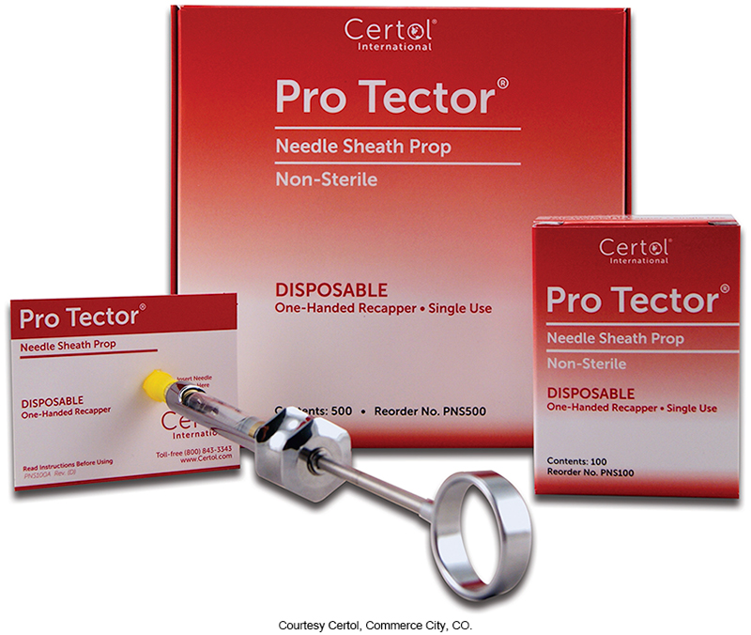
Engineering Controls
Whenever possible, engineering controls should be the primary method to reduce exposure to bloodborne pathogens.
These controls remove or isolate the hazard.
They are frequently technology-based, for example: Self-sheathing anesthetic needles, safety scalpels, and needleless IV ports.
Sharps containers and needle recapping devices.

Slide 54
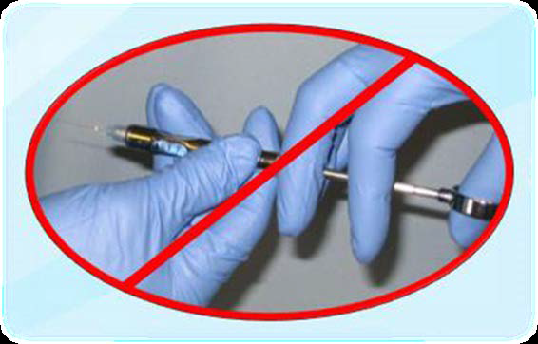
Work Practice Controls
Change the way you perform tasks.
Examples include:
- Not bending or breaking needles.
- Not passing a syringe with an unsheathed needle.
- Removing burs before disassembling the handpiece from the dental unit.
- Using instruments in place of fingers for tissue retraction or palpation.

Slide 55
Sharps Safety Practices
Be Prepared
1
Be Aware
2
Dispose with Care
3

Slide 56
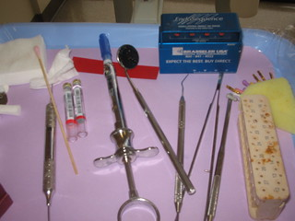
Be Prepared
Before beginning a procedure:
• Organize equipment.
• Ensure adequate lighting.
• Keep sharps pointed away from user.
• Locate a sharps disposal container.

Slide 57
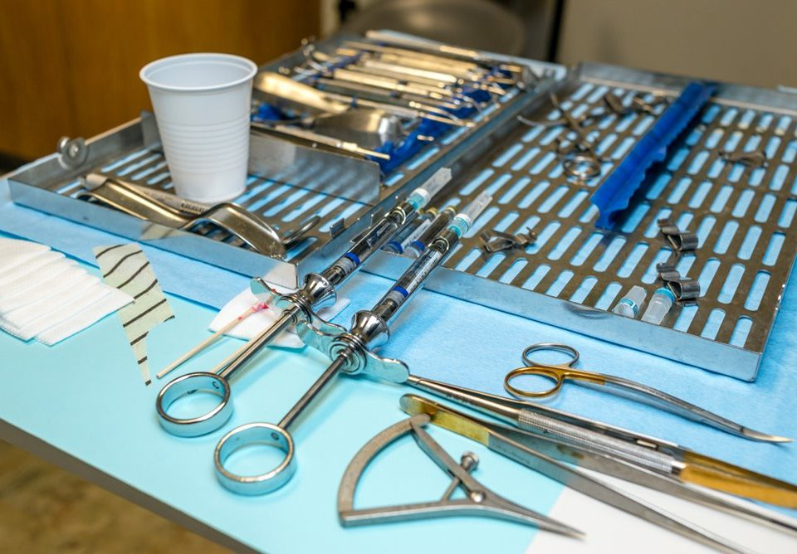
Be Aware
During a procedure:
• Maintain visual contact with sharps.
• Be aware of nearby personnel.
• Control the location of sharps to avoid injury.
• Do not pass needles unsheathed.
• Consider alerting others when passing sharps and consider a neutral zone for placing and retrieving sharps.
• Activate the safety feature of devices as soon as procedure is completed.

Slide 58
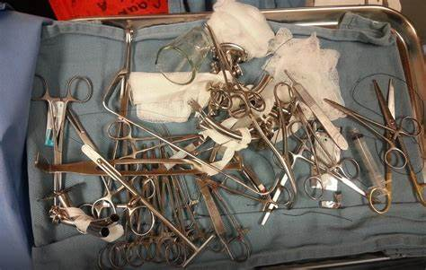
Clean-up—Dispose with Care
Check procedure trays and waste materials for exposed sharps before handling.
• Look for sharps and equipment left behind inadvertently.
• Transport reusable sharps in a closed, labeled container.
• Secure the container to prevent spilling contents.

Slide 59
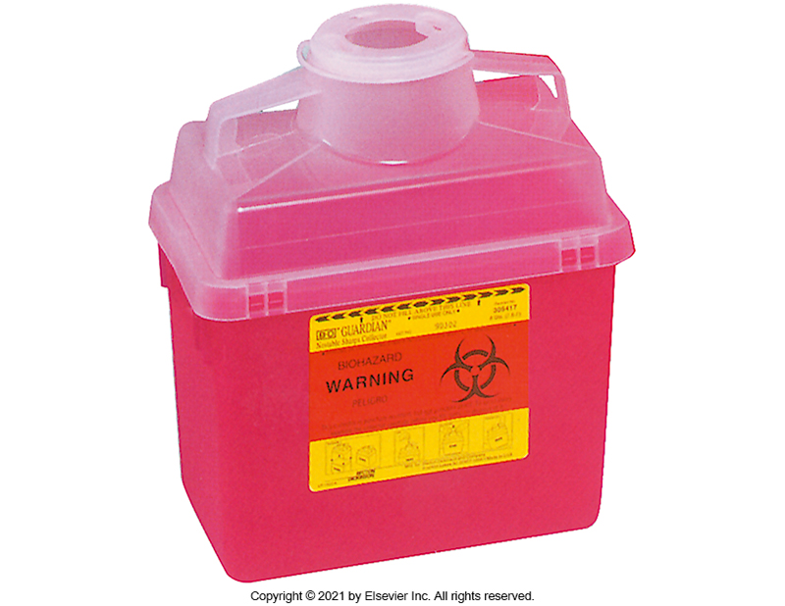

Sharps Containers
Keep hands behind sharps during disposal.
Never put hands or fingers into sharps containers.
Visually inspect sharps containers for overfilling.
Replace containers before they become overfilled.

Slide 60
Evaluating Safety Devices
The Needlestick and Prevention Act mandated changes to the OSHA Bloodborne Pathogens Standard in 2001:
DHCP directly responsible for patient care (e.g., dentists, hygienists, dental assistants) must identify, evaluate and select devices with engineered safety features at least annually and as they become available.

Slide 61
Developing Programs to Prevent Sharps Injuries
Assign a staff person knowledgeable about or willing to be trained in injury prevention (i.e., a safety coordinator or an infection control coordinator) to:
– Promote safety awareness.
– Facilitate prompt reporting and postexposure management of injuries.
– Identify unsafe work practices and devices.
– Coordinate the selection and evaluation of safer dental devices.
– Organize staff education and training.
– Complete the necessary reporting forms and documentation.
– Monitor safety performance.

Slide 62
Identifying Safer Dental Devices
Developing evaluation criteria.
1
Screening devices.
2
Evaluating devices.
3

Slide 63


Occupational Exposure Incident
Percutaneous injury:
– Needlestick, puncture wound, or cut.
Splash of blood or body fluid onto:
– Mucous membranes of the eyes, nose, or mouth.
– Non-intact skin (e.g., chapped, abraded, dermatitis).

Slide 64
Post-exposure Management Program
Clear policies and procedures.
Education of DHCP.
Rapid access to qualified health care professional who can provide:
– Clinical care.
– Postexposure prophylaxis (PEP).
– Testing of source patients and DHCP.

Slide 65
Post Exposure Management
Wound management.
Exposure reporting.
Assessment of infection risk:
1. Type and severity of exposure.
2. Bloodborne pathogen status of source person.
3. Susceptibility of exposed person.

Slide 66
Safe Injection Practices
A set of measures intended to prevent transmission of infectious diseases between one patient and another or between a patient and dental health care personnel (DHCP) during preparation and administration of injectable (e.g., intravenous, intramuscular injection) medications.

Slide 67
Injectable Medications
Medications that are injected into the body
—most frequently by intravenous or intramuscular routes.
• DHCP most frequently handle injectable medications when administering local anesthesia.
– Handle safely to prevent transmission of infections.
• Cases of disease transmission have been reported.
– A 2013 patient-to-patient transmission of hepatitis C virus in a dental health care setting likely occurred through a combination of unsafe injection practices.

Slide 68
Administration of Local Anesthesia
Needles and anesthetic cartridges are used for one patient only, and the dental cartridge syringe is cleaned, and heat sterilized between patients.

Slide 69
Sterilization and Disinfection of Patient-Care Items and Devices
Categories of Patient-Care Items
Three categories:
1. Critical.
2. Semi-critical.
3. Noncritical.
Based on intended use and the potential risk of disease transmission

Slide 70
Critical Items
Penetrate soft tissue or contact bone, enter into or contact the vascular system or other normally sterile tissue.
Greatest risk of transmitting infection.
Must be heat sterilized between use, or sterile single-use, disposable devices must be used.
Examples: surgical instruments and periodontal scalers.

Slide 71
Semi-critical Items
Contact mucous membranes or non-intact skin (e.g., exposed skin that is chapped, abraded, or has dermatitis).
Lower risk of transmission.
Should be heat sterilized or high-level disinfected.
Examples: mouth mirrors, amalgam condensers, and reusable impression trays.

Slide 72

Semi-critical Items Special Considerations—Dental Handpieces
Follow manufacturer’s instructions to safely reprocess dental handpieces and accessories (e.g., low-speed motor, reusable prophylaxis angles).
Clean and heat sterilize between patient uses.
Do not subject the handpiece to high-level disinfection and do not simply wipe the surface with a low-level disinfectant

Slide 73

Semi-critical Items Special Considerations—Digital Sensors
Follow manufacturer’s instructions to safely reprocess digital radiography equipment.
Ideally, barrier protection should be used, followed by cleaning and heat sterilization or high-level disinfection between patients.
If the item cannot tolerate these procedures, then at minimum, barrier protection should be used, followed by cleaning and disinfection with an intermediate-level disinfectant between patients.

Slide 74
Noncritical Items
Contact intact skin.
Barrier protect or clean and disinfect (if visibly soiled) using a low to intermediate-level (i.e., tuberculocidal) disinfectant.
Examples: x-ray head or cone, facebows, blood pressure cuff.

Slide 75

Single-Use (Disposable) Devices
Intended for use on one patient during a single procedure.
Usually not heat-tolerant.
Cannot be reliably cleaned.
Do NOT reprocess.
Examples: syringe needles, prophylaxis cups, and plastic orthodontic brackets.

Slide 76

Personal Protective Equipment when Processing Instruments
To prevent disease agents from a previous patient from being transferred to you, another dental team member, or the next patient, instrument processing must be performed in a consistent and disciplined manner.
You must always use personal protective equipment (PPE), including utility gloves, mask, eyewear, and protective clothing, when processing instruments.

Slide 77

Instrument-Processing Area
The ideal instrument-processing area:
  Should be dedicated only to instrument processing
  Should be physically separated from the operatories and dental laboratory
  Should not be a part of a common walkway

Slide 78
Cleaning
Cleaning should always occur before disinfection or sterilization.
– Presence of soil can compromise the disinfection or sterilization process.
Automated or manual.
Minimize exposure potential.
Use carrying containers to transport contaminated instruments.
Wear personal protective equipment (e.g., heavy duty utility gloves, mask, protective eyewear and clothing).

Slide 79





Precleaning and Packaging Instruments
Instruments may be precleaned in one of three ways:
  Hand scrubbing - is the least desirable method of cleaning instruments because it requires direct hand contact with the contaminated instrument.
  Ultrasonic cleaning -Ultrasonic cleaners are used to loosen and remove debris from instruments.
  Instrument-washing machine

Slide 80
Preparation and Packaging
Wrap, package, or place instruments in containers before heat sterilization.
– Instruments should be thoroughly dry before they are packaged, wrapped, or otherwise contained.
Follow manufacturer’s instructions.
For example: open hinged instruments, disassemble instruments if required, and ensure that packaging materials are compatible with the method of heat sterilization being used.

Slide 81

Methods of Sterilization
Sterilization destroys all microbial forms, including bacterial spores. Sterile is an absolute term; there is no “partially sterile” or “almost sterile.”
All reusable items (critical and semi critical instruments) that come into contact with the patient’s blood, saliva, or mucous membranes must be heat sterilized.
The three most common forms of heat sterilization in the dental office are:
  Steam
  Chemical vapor
  Dry heat

Slide 82
Sterilization Monitoring: Types of Indicators
Mechanical: Measures time, temperature, and pressure.
Chemical: Change in color when physical parameter is reached.
Biological (spore tests):
- Uses biological spores to assess the sterilization process directly.
Indicators are specific to the type of sterilization used.

Slide 83
Record Keeping
Sterilization monitoring (e.g., biological, mechanical, chemical) and equipment maintenance records are important components of a dental infection prevention program.
Ensures cycle parameters have been met and establishes accountability.
If there is a problem with a sterilizer, documentation helps to determine if an instrument recall is necessary.

Slide 84
Storage of Sterile and Clean Items and Supplies
Store clean items in dry, closed, or covered cabinet.
Use date- or event-related shelf-life practices.
Examine wrapped items carefully before use.
When packaging of sterile items is damaged, clean, repackage, and heat sterilize again.

Slide 85
Environmental Surfaces
A surface or equipment that does not contact patients directly.
• Can become contaminated through touch, splash, or droplets generated during patient care.
• Can serve as reservoirs of microbial contamination.

Slide 86
Environmental Infection Prevention and Control
Categories of Environmental Surfaces
Clinical contact surfaces:
- High potential for direct contamination from spray or spatter or by contact with gloved hands of dental health care personnel (DHCP).
- Emphasis for cleaning and disinfection should be placed on these surfaces.
- Examples: light handles, bracket trays, switches on dental units, computer equipment.

Slide 87
Environmental Infection Prevention and Control (cont.)
Housekeeping surfaces:
- Do not come into direct contact with patients or devices.
- Can be decontaminated with less rigorous methods than those used on dental patient-care items and clinical contact surfaces.
- Examples: floors, walls, and sinks.

Slide 88

Surface Barriers
Barriers protect clinical contact surfaces, especially those that are difficult to clean (e.g., switches on dental chairs, computer equipment).
Change barriers between patients.

Slide 89
CDC Dental Setting-specific considerations
For dental facilities with open floor plans, to prevent the spread of pathogens there should be:
  At least 6 feet of space between patient chairs.
  Physical barriers between patient chairs. Easy-to-clean floor-to-ceiling barriers will enhance effectiveness of portable HEPA air filtration systems (check to make sure that extending barriers to the ceiling will not interfere with fire sprinkler systems).
  Operatories should be oriented parallel to the direction of airflow if possible.

Slide 90
CDC Dental Setting-specific considerations (cont.)
  Where feasible, consider patient orientation carefully, placing the patient’s head near the return air vents, away from pedestrian corridors, and toward the rear wall when using vestibule-type office layouts.
  Ensure to account for the time required to clean and disinfect operatories between patients when calculating your daily patient volume.

Slide 91

General Cleaning Recommendations
Use personal protective equipment (e.g., heavy-duty utility gloves, masks, protective eyewear).
Cleaning should always come before disinfection.
Follow manufacturer’s instructions for proper use of hospital disinfectants registered by the
US Environmental Protection Agency (EPA).–EPA-registered disinfectants
Do not use liquid chemical sterilant or high-level disinfectants.

Slide 92


Cleaning Clinical Contact Surfaces
Risk of transmitting infections greater than for housekeeping surfaces
Barrier protect and change between patients
OR
Clean followed by disinfection with an EPA-registered low-level (HIV/HBV claim) to intermediate-level (tuberculocidal claim) hospital disinfectant.

Slide 93

Cleaning Clinical Contact Surfaces
To clean and disinfect the dental operatory after a patient without suspected or confirmed COVID-19, wait 15 minutes after completion of clinical care and exit of each patient to begin to clean and disinfect room surfaces.
To clean and disinfect the dental operatory after a patient with COVID-19, DHCP should delay entry into the operatory until a sufficient time has elapsed for enough air changes to remove potentially infectious particles.

Slide 94

Regulated Medical Waste Management
Infectious waste that carries a substantial risk of causing infection during handling and disposal.
Examples: gauze soaked in blood, extracted teeth, and contaminated sharp items.
Requires special storage, handling, neutralization, and disposal and is covered by federal, state, and local rules and regulations.
- Proper containment to prevent injuries and leakage.
Never include extracted teeth with amalgam in waste that will be treated with heat or incinerated.

Slide 95

Dental Unit Waterlines and Biofilm
Microbial biofilms form in narrow-bore tubing of dental units.
•Biofilms serve as a microbial reservoir.
•Primary source of microorganisms is municipal water supply.

Slide 96
Microorganisms of Concern
• Legionella species: – Transmission occurs primarily through inhalation of infectious aerosols. – Pontiac Fever, Legionnaires’ disease.
• Pseudomonas species: – Bacterial infection that usually occurs in a hospital setting or in people with weakened immune systems. – Most common type infecting humans is Pseudomonas aeruginosa. – Can be mild or severe
• Nontuberculous Mycobacteria: – Can cause infection on skin and in soft tissue and organs. – Associated with outbreaks in health care and dental settings.

Slide 97
Disease Transmission Associated with Dental Unit Waterlines
2011 transmission of Legionella, Italy(1): - 82-year-old woman
2015 transmission of Mycobacterium abscessus, Georgia(2):
- 23 cases—all children.
- All received pulpotomy procedures.
2016 transmission of Mycobacterium abscessus, California(3):
- Infections reported in children who had pulpotomy procedures.
- As of May 2, 2017, 68 potential cases have been reported.

Slide 98

CDC Recommendations for Dental Unit Water Quality
Use water that meets US Environmental Protection Agency (EPA) regulatory standards for drinking water (i.e., <500 CFU/mL of heterotrophic water bacteria) for routine dental treatment output water.
Consult with the dental unit manufacturer for appropriate methods and equipment to maintain the recommended quality of dental water.
Follow recommendations for monitoring water quality provided by the manufacturer of the unit or waterline treatment product.

Slide 99


CDC Recommendations for Dental Unit Water Quality (Cont.)
Discharge water and air for a minimum of 20–30 seconds after each patient, from any device connected to the dental water system that enters the patient’s mouth (e.g., handpieces, ultrasonic scalers, air or water syringes).
Consult with the dental unit manufacturer on the need for periodic maintenance of anti-retraction mechanisms.

Slide 100


Improving Dental Unit Water Quality
Available Technology
- Independent reservoirs.
- Chemical treatment.
- Filtration.
- Combinations of technologies.
- Sterile water delivery systems.
DHCP should always consult with the dental unit manufacturer for
appropriate methods to maintain the recommended dental unit water quality.

Slide 101

OSAP: Test Every 90 days
Publishes position paper on waterline safety
Recommends…
Quarterly testing
Everyone is doing it
Because it works
Quarterly testers fail 1/6 as often as everyone else

Slide 102

Manufacturers IFU have recently changed

Slide 103
Oral Surgical Procedures
Involve the incision, excision, or reflection of tissue that exposes the normally sterile areas of the oral cavity.
Examples:
– Biopsy.
– Periodontal surgery.
– Apical surgery.
– Implant surgery.
– Surgical extractions of teeth (e.g., removal of erupted or nonerupted tooth requiring elevation of the mucoperiosteal flap, removal of bone or section of tooth, and suturing if needed).
Use sterile irrigating solutions.

Slide 104
Sterile Irrigating Solutions
Use sterile saline or sterile water as a coolant/irrigator when performing surgical procedures.
Use devices designed for the delivery of sterile irrigating fluids.

Slide 105

Be safe and healthy..
Thank you !!!

